Slide 1
Melbourne Coding Club
Data communication
Socket IO

Slide 2
Requirements
Bi-directional
Real-time
Multiple clients, one server
Runs locally as well as on the network / Internet
Compatible with Python

Slide 3
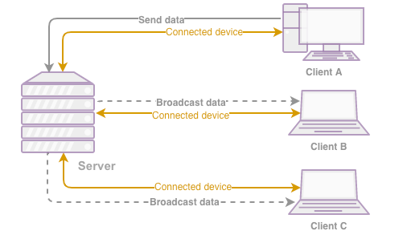
Broadcasting messages to everyone

Slide 4
Python Socket IO
pip install python-socketio
pip install eventlet

Slide 5
Client implementation
import socketio
sio = socketio.Client()
@sio.event
def connect():
print('connection established')
@sio.event
def my_message(data):
print('message received with ', data)
sio.emit('my response', {'response': 'my response'})
@sio.event
def disconnect():
print('disconnected from server')
sio.connect('http://localhost:5000')
sio.wait()

Slide 6
import eventlet
import socketio
import eventlet.wsgi
sio = socketio.Server(async_mode='eventlet')
app = socketio.WSGIApp(sio)
@sio.event
def connect(sid, environ):
print('connect ', sid)
@sio.event
def my_message(sid, data):
print('message ', data)
@sio.on("update")
def update(sid, data):
print(data)
sio.emit('message', {'sender': sid , 'echo': data}, broadcast=True)
@sio.event
def disconnect(sid):
print('disconnect ', sid)
if __name__ == '__main__':
#uvicorn.run(app, host='127.0.0.1', port=5000)
eventlet.wsgi.server(eventlet.listen(('', 5000)), app)

Slide 7
Game comms mechanics
On Blue’s app
Blue Tank current location is x = 20, y = 100
Blue Tank moves to left by 10 pixels.
JSON message sent to server:
{
'id': 1234,
'team': ‘blue’,
'x':10, #new destination
'y':100, 'bulletX':-1, #arbitary number to hide the bullet
'bulletY':-1
}
On Red’s app, Blue Tank moves to left in real-time (almost)

